Slide 1

INDIAN BANKING SYSTEM
Guided by:
Siddharth Gajbhiye
Prepared By:
Abhisek Ojha
Atanu Sabyasachi Swain

Slide 2

AGENDA
Introduction
About Project
System Design
How it Program Work

Slide 3

INTRODUCTION
The INDIAN banking system is a crucial component of the country's economy, serving as the backbone for financial stability and economic development. It has evolved significantly over the years and now operates with a sophisticated structure that includes various types of banks, each catering to different segments of the economy.

Slide 4

ABOUT PROJECT
An online banking system built using Python. This system allows the customer and banking staff/manager to manage all transactions easily.
The primary purpose of this system is to function the user activities in Banking system.

Slide 5

SYSTEM DESIGN
In this online banking system, there are 2 different menus, namely:
Welcome input
Customer
Account creation
Money Deposit
Money Withdrawal
Available Balance
Account Details
Exist

Slide 6
HOW IT PROGRAM WORK
ENHANCING THE PRESENTATION

Slide 7

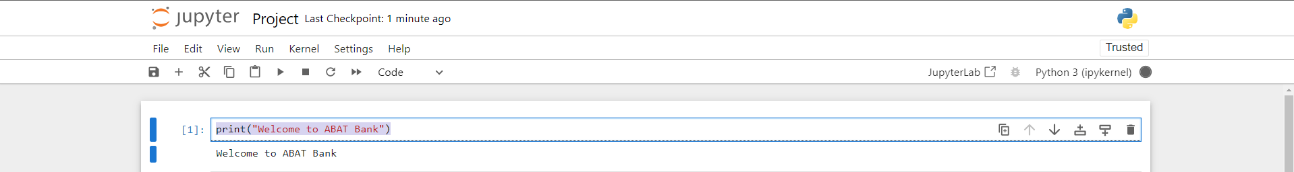
WELCOME INPUT
print("Welcome to ABAT Bank")

Slide 8
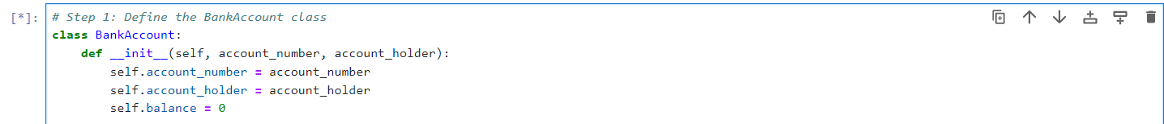
HOW TO CREATE A CLASS AND CONSTRUCTER
Let’s create a class and initiate the class with the constructor:
The class keyword declares an Account class.
The __init__() method is the constructor, defined with the special double underscore notation at the beginning and end.
self is a reference to the instance of the class. It is the first parameter of all instance methods in Python.
name is the name of the account holder.
account_number is a unique identifier for the savings account, and balance are parameters passed to the constructor.
Inside the constructor self.name, self.account_number, and self.balance are attributes of the class Account that are initialized with the values of name, account_number and balance, respectively.

Slide 9
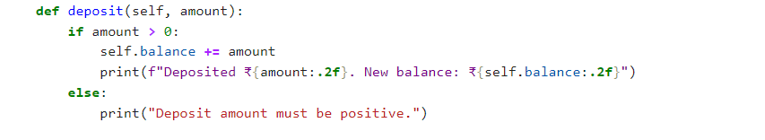
How to create a deposit method
The deposit method allows users to add funds to their account.
The method takes an additional parameter amount, which is the amount to be deposited.
Inside the method, the amount is added to the current balance using self.balance += amount.
A message is printed showing the depositor name and the amount deposited and the balance is updated.

Slide 10
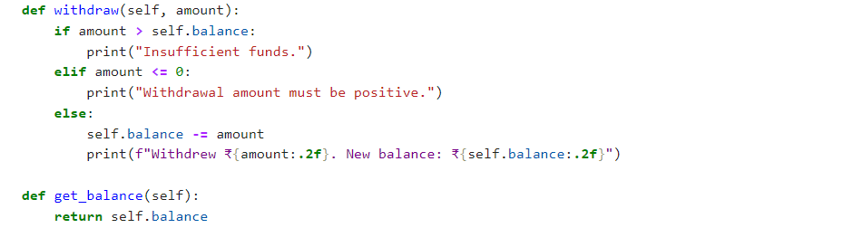
How to create a withdraw method
The withdraw method allows users to withdraw funds from their account.
The method also takes an amount parameter which is the amount our user wants to withdraw.
The method checks if the account balance (self.balance) is greater than or equal to the amount our user wants to withdraw.
If the balance is enough, the withdrawal amount is removed from the balance using self.balance -= amount.
If the balance is not enough, a message stating “Insufficient funds” is printed to the user.

Slide 11

HOW TO DISPLAY THE ACCOUNT DETAILS
Display_aaccount_details(self) method is used to display the account details like:
Account number
Account Holder
Balance

Slide 12
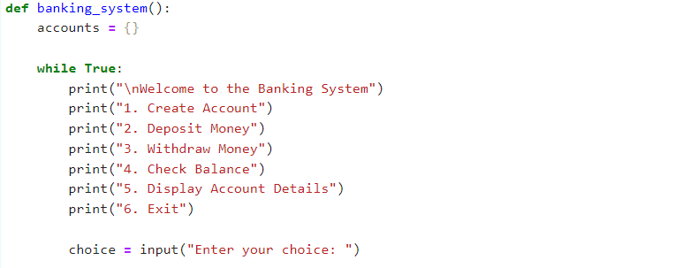
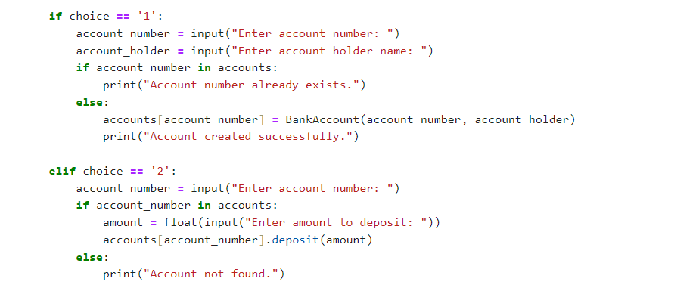
FUNCTION TO INTERACT WITH BANKING SYSTEM
USER CAN CHOOSE FROM THE 6 INPUTS AVAILABLE IN BANKING SYSTEM
USING OPTION 1 NEW CUSTOMER CREATE THE ACCOUNT, USING OPTION 2 USER WILL ABLE TO DEPOSIT MONEY

Slide 13
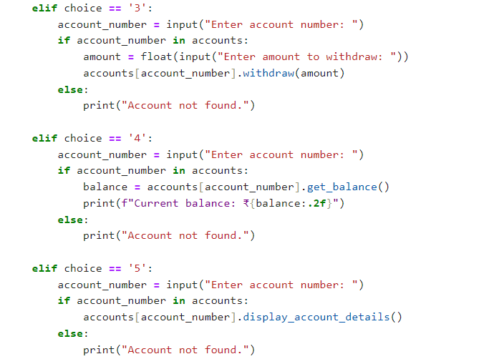
FUNCTION TO INTERACT WITH BANKING SYSTEM
USING OPTION 3 USER WILL ABLE TO WITHDRAW MONEY THROUGH THE INPUT OF ACCOUNT NUMBER
USING OPTION 4 USER WILL ABLE TO VIEW THE AVILABLE BALANCE
USING OPTION 5 USER WILL ABLE TO SEE THE ACCOUNT DETAILS

Slide 14
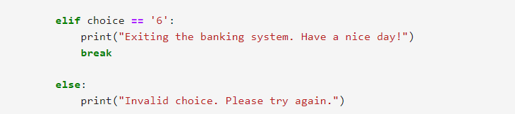
EXISTING THE BANKING SYSTEM
USING OPTION 6 USER WILL EXIST FROM THE SYSTEM SHOWING, DISPLAY STATING “Existing the banking system. Have a nice day”.

Slide 15

THANK YOU
Resources:
www.google.com

